Slide 1
Commodity Trade Statistics
Documentation

Slide 2
Table of Contents
Slide 3 Overview
Slide 4 Commodities With Highest Price Index Per Year
Slide 5 Commodities with the Lowest Price Index per Year
Slide 6 Average Price Index by Continent
Slide 7 frequency of each category
Slide 8 frequency of Each Flow
Slide 9 Top 10 Countries by Value of Import
Slide10 Top 10 Countries by Value of Export
Slide11 Live Animal Import/Export Value By Continent
Slide12 Coffee, Tea and Spices Import/Export Value By Continent
Slide13 Coffee, Tea and Spices Import/Export Value By Countries(Top 5)
Slide14 Observation and Conclusion
Slide 15 Observation and Conclusion Continued

Slide 3
Overview
The dataset provides information on various trade commodities, their values and how they are spread out across various countries. The data spans from the year 1988 to 2016 and show both import and export commodities.

Slide 4
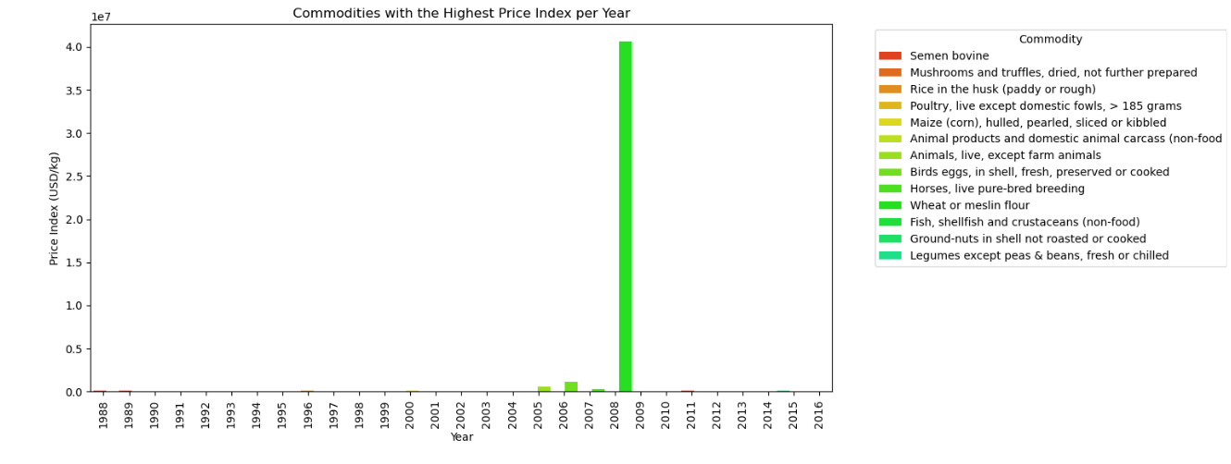
Commodities With Highest Price Index Per Year

Slide 5
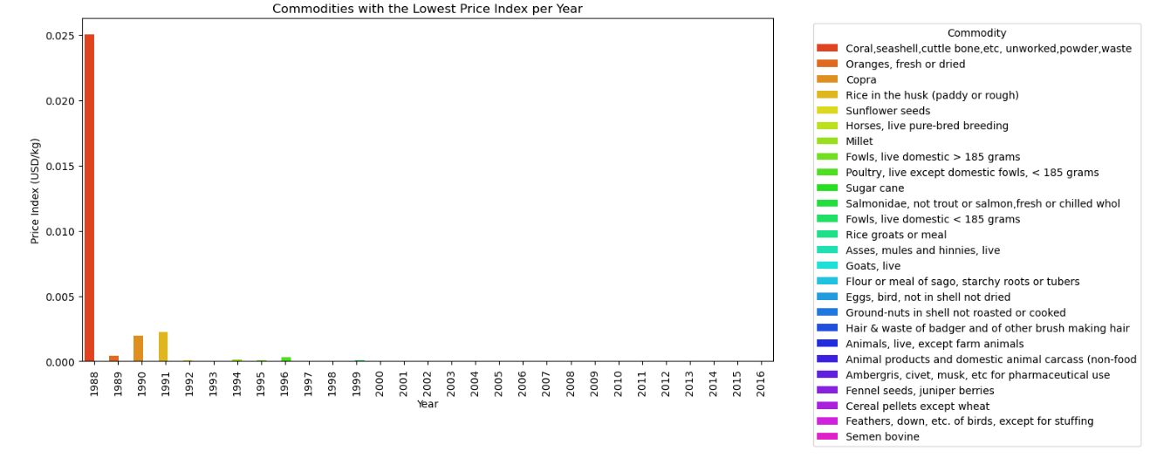
Commodities with the Lowest Price Index Per Year

Slide 6
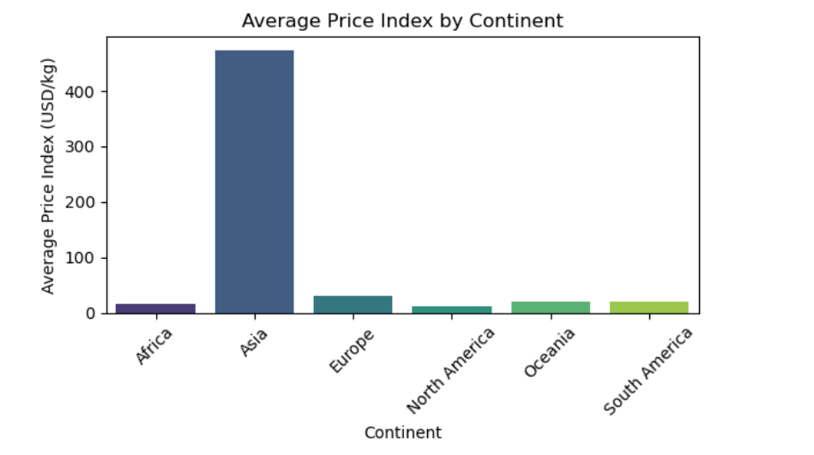
Average Price Index by Continent

Slide 7
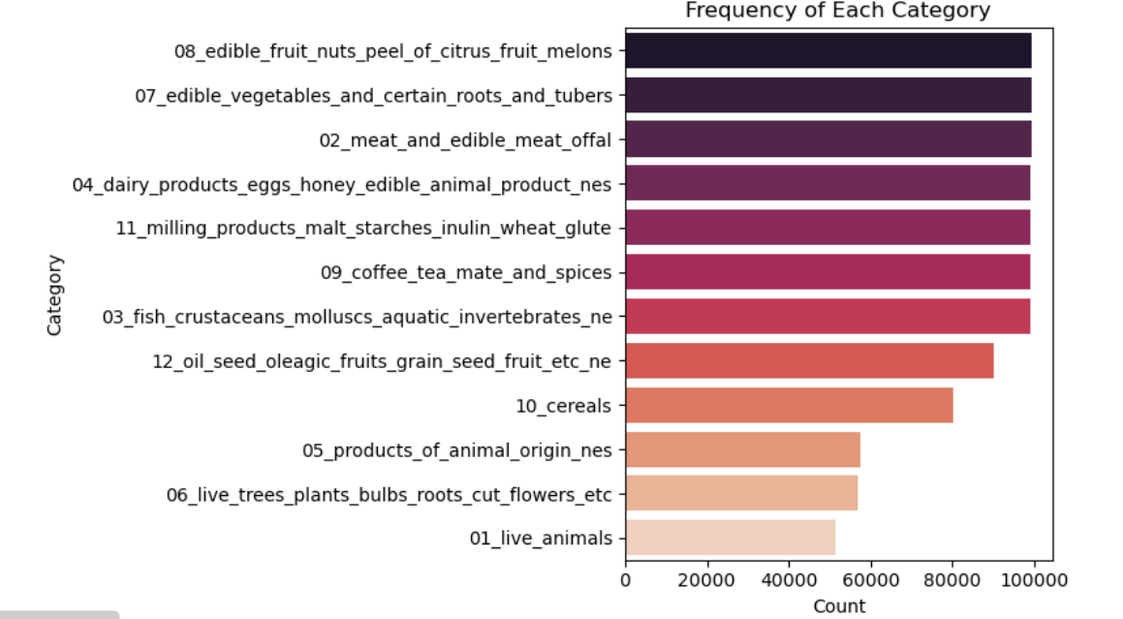
frequency of each category

Slide 8
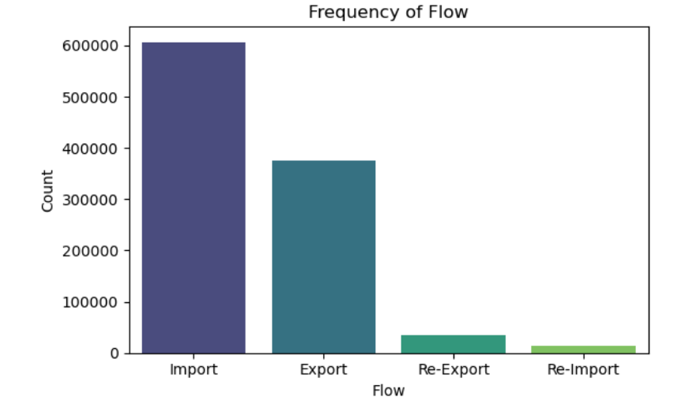
Frequency of each flow

Slide 9
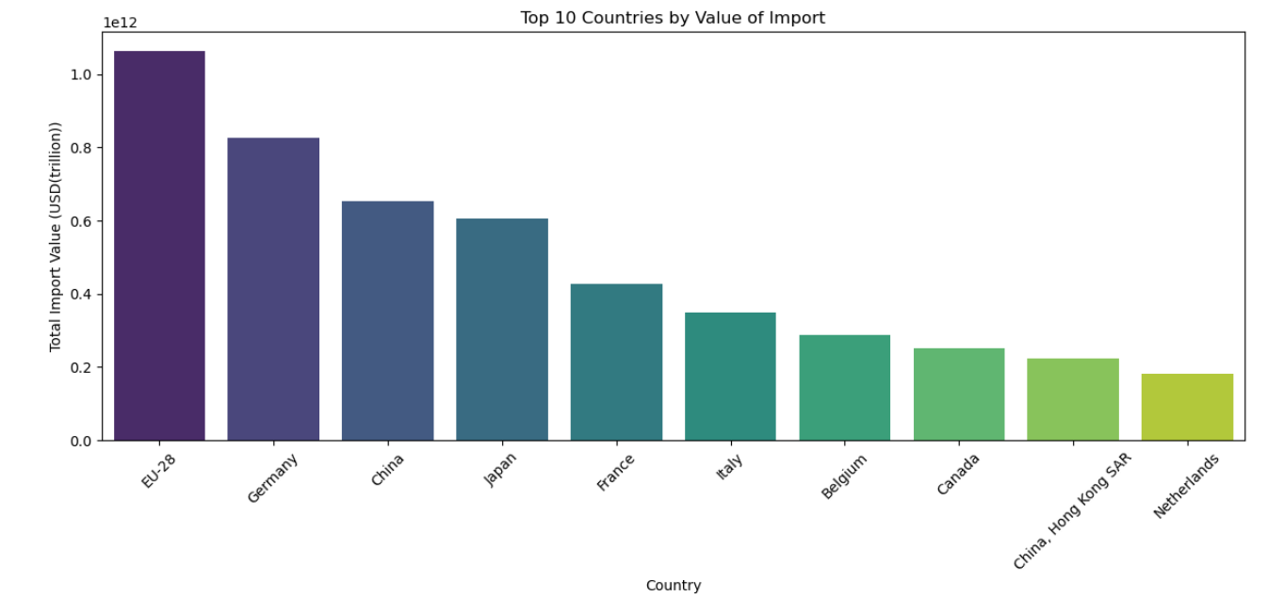
Top 10 Countries by Value of Import

Slide 10
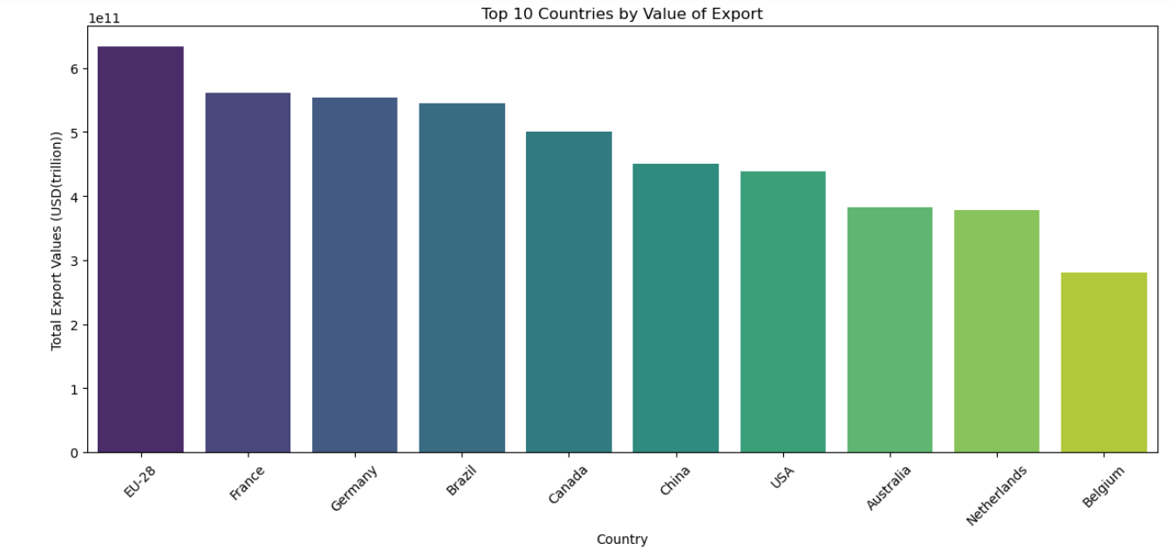
Top 10 Countries by Value of Export

Slide 11
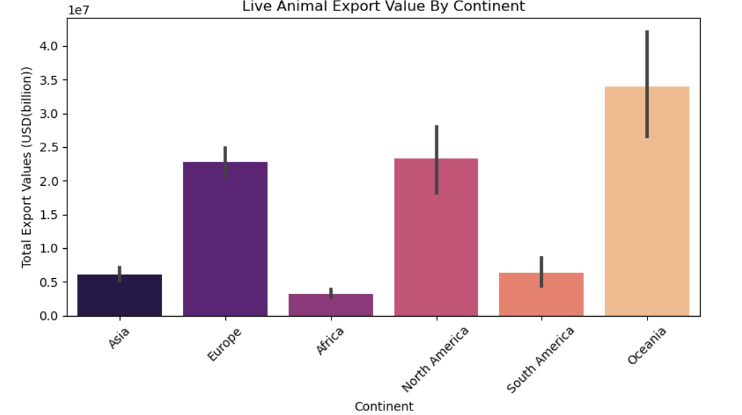
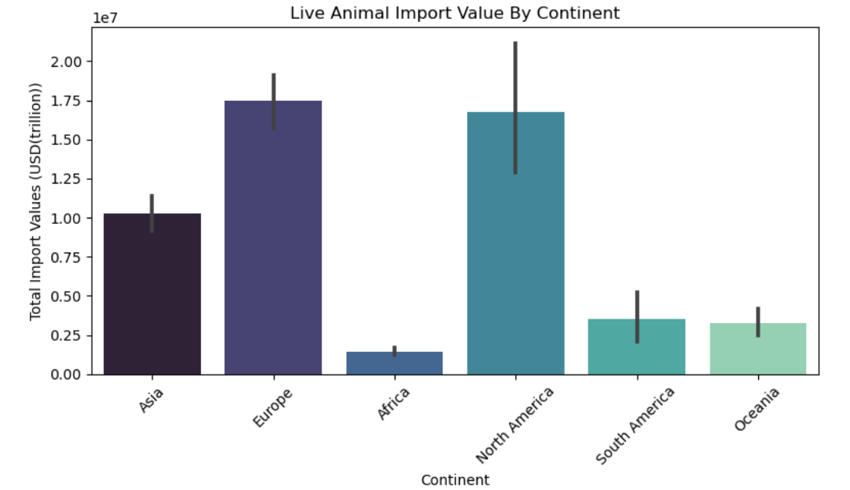
Live Animal Import/Export Value By Continent

Slide 12
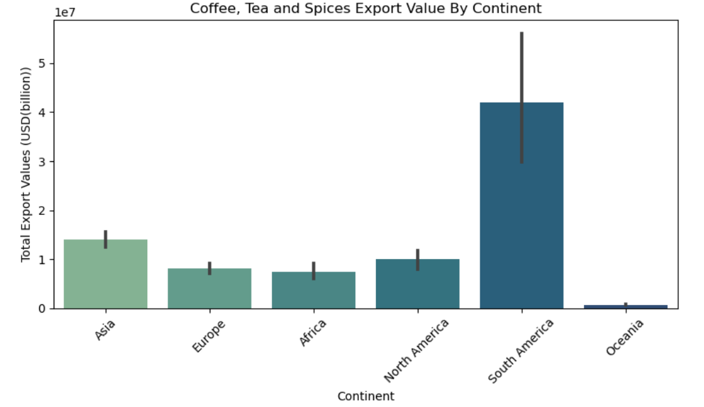
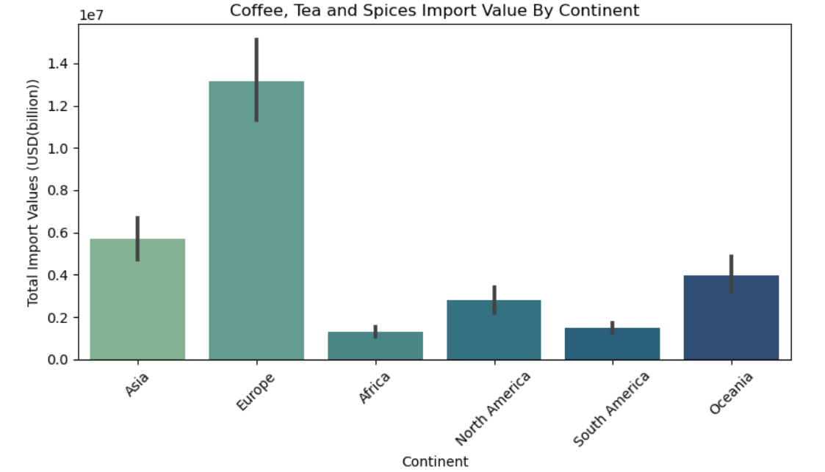
Coffee, Tea and Spices Import/Export Value By Continent
Export
Import

Slide 13
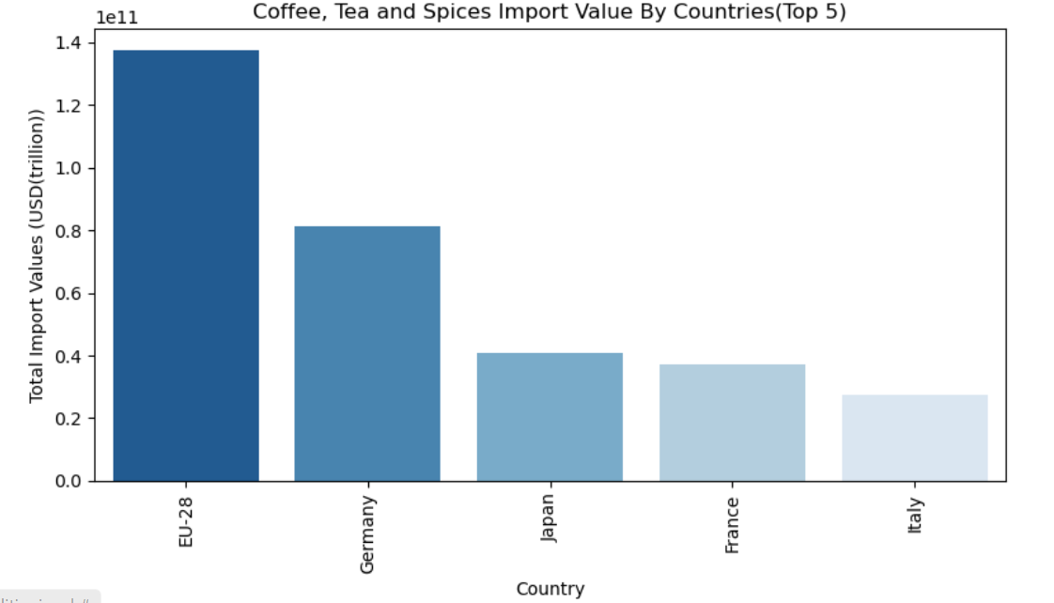
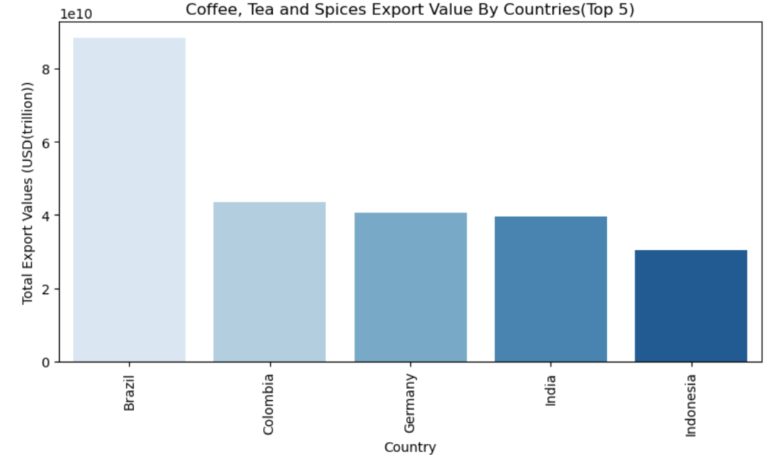
Coffee, Tea and Spices Import/Export Value By Countries(Top 5)
Import
Export

Slide 14
Observation and Conclusion
Asia has by far the highest price index among the continents, indicating that the commodities being traded from or to Asia are significantly more valuable on a per-unit basis than those from other continents.
Europe has a moderate price index and the second highest price index among all the continents, which suggests that the traded commodities are less valuable per unit compared to Asia but higher than in Africa, North America, Oceania, and South America.
North America has the lowest price index, which indicate the export or trade of bulk commodities that have lower unit prices.
The overall highest price index of 40,610,759.25 USD/kg came from the importation of Wheat or Meslin flour to Afghanistan in 2008
The EU-28 represents the combined import trade value of the European Union's 28 member countries. This high value underscores the EU's status as one of the largest and most integrated markets in the world, relying heavily on imports to meet its diverse consumer. Germany, as the largest economy in Europe, imports a vast array of commodities to support its robust consumers and stands second on trade values of imported commodities. China has the 3rd highest import trade value. Its large import trade value reflects its role as a global powerhouse, importing raw materials essential for production and export activities.
In terms of exports, the EU-28 has the highest trade value. This large value indicates the EU's substantial influence in global trade, exporting a wide range of goods and agricultural products.
France sits in second place when it comes to the trade value of export. It is a major exporter of agricultural products contributing to its trade value. Its strategic location in Europe enhances its export capabilities.

Slide 15
Observation and Conclusion Continued…
Oceania is the leading continent in live animal exports, with a value of over $3.4 billion. This is primarily driven by Australia and New Zealand, which are major exporters of livestock such as sheep, cattle, and horses. The region's extensive agricultural lands, advanced farming techniques, and favourable climate contribute to its leading position.
North America, with the United States and Canada as major contributors, exports a significant number of live animals. The livestock industry in these countries includes cattle, pigs, and poultry.
Europe has a well-developed and diverse livestock industry, exporting a variety of live animals such as cattle, pigs, sheep, and horses.
Africa has the smallest export value for live animals, indicating limited participation in global markets. Infrastructure, disease control, and market access are some of the challenges that affect the livestock export industry in Africa.
South America is the largest exporter of coffee, tea, and spices, driven primarily by Brazil and Colombia, which are the world's top coffee producers. The region's climate and geography are ideal for coffee cultivation, giving it a competitive advantage. Oceania has the smallest export value in this category, primarily due to limited suitable land for large-scale coffee and tea production

